Slide 1
Lung Cancer Using Predictive Modeling and Analysis
PRESENTED BY:-
1.RUTUJ GANGAWANE(250243025012)
2.HRUSHIKESH SARVADE(250243025035)
3.ADITYA GAWANDE(250243025001)
4.UTKARSH KAKADEY(250243025050)
Guided by:
Mr. Milind Kapse

Slide 2
INTRODUCTION
Accurate prediction of survival rates is vital for improving clinical outcomes, optimizing treatment strategies, and enhancing communication with patients. The project aims to predict lung cancer patient survival outcomes using various attributes such as age, gender, cancer stage, and lifestyle factors. By using machine learning, we can analyze complex datasets to improve prognostic accuracy. This approach helps in making better-informed treatment decisions and providing personalized patient care. It also aids in identifying high-risk patients, which ultimately improves survival rates and quality of life.

Slide 3
Problem Definition
We aim to predict the survival outcome of patients having lung cancer using different attributes such as age, gender, cancer stage, treatment type, family history and lifestyle factors, which may influence survival rates. This will lead to better-informed treatment decisions and personalized patient care. It also facilitates the identification of high-risk patients, ultimately improving survival rates and quality of life

Slide 4
PROJECT WORKFLOW
Data Processing: The project begins by placing the raw dataset and performing preprocessing on a using PySpark.
Database Integration: The preprocessed dataset is then moved to local Windows environment and dumped into a MySQL database.
Model Training: The data from MySQL is used to train machine learning models.
Deployment: The best model is saved as a Pickle file and used in a Streamlit application with a user-friendly UI.

Slide 5
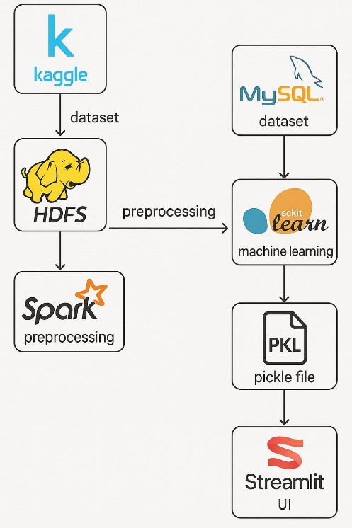
Architecture

Slide 6
PREPROCESSING USING SPARK
Cleanup: Handled missing values.
Feature Engineering: Converted date columns to numerical features.
Encoding: Used String Indexer for categorical features .
Class Imbalance: The dataset was under sampled to fix class imbalance, as seen in the class distribution.

Slide 7
MODEL TRAINING AND SELECTION
Models Trained: The preprocessed dataset was used to train a
variety of classification models:
Random Forest
XGBoost
CatBoost
Logistic Regression
Model Selection: Based on performance metrics, the Random Forest and XGBoost models were the top performers. The Random Forest model was ultimately selected for deployment after hyperparameter tuning.

Slide 8
RANDOM FOREST PERFORMANCE
Tuned Accuracy: 85.75%
Classification Report:-
1. Class 0 (Non-Survived):-
Precision: 0.78 — This means 78% of the patients predicted to be in this class were correct.
Recall: 1.00 — The model correctly identified all actual non-survived patients, which is excellent for a task where false negatives are critical.
2. Class 1 (Survived):
Precision: 1.00 — Every patient predicted as 'survived' was correct, showing the
model is highly precise for this class.
Recall: 0.72 — The model only identified 72% of the actual survived patients, meaning it missed 28% of them.

Slide 9
HYPERPARAMETER TUNING
RANDOMIZED SEARCH CV : This method randomly samples combinations of hyperparameters from a predefined grid, which is more efficient than exhaustively searching all possible combinations (GridSearchCV).
Parameter Grid: The following ranges were used for the Random Forest model:
n_estimators: [100, 300, 500]
max_depth: [10, 20, None]
min_samples_split: [2, 5, 10]
class_weight: ['balanced', None]

Slide 10
DEPLOYMENT
Model Saving: The trained Random Forest model was saved as a Pickle file (best_lung_cancer_model.pkl).
User Interface (UI): A web application was developed using Streamlit.
Functionality: The Streamlit app uses the saved Pickle file to make predictions on new patient data entered through the UI.

Slide 11
Streamlit
Streamlit is an open-source Python framework designed for building interactive and data-driven web applications. It is particularly popular among data scientists, machine learning (ML) practitioners, and analysts due to its simplicity and ability to create fully functional web applications.

Slide 12
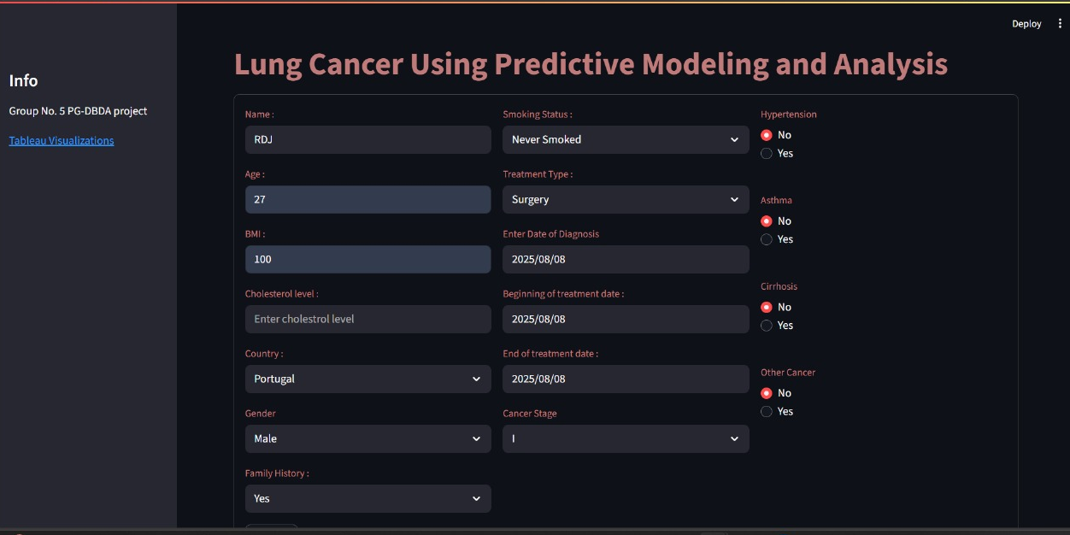
UI USING STREAMLIT

Slide 13
Exploratory Data Analysis(EDA)
Survival Distribution
Age distribution by Survival Status
Cancer Stage Distribution by Survival Status
Treatment Type Distribution by Survival Status
smoking status Distribution by Survival Status
BMI and Cholesterol levels distribution by Survival Status

Slide 14
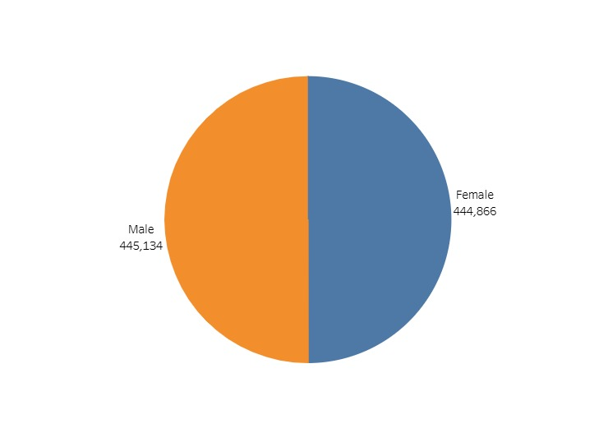
EDA – Survival Distribution

Slide 15
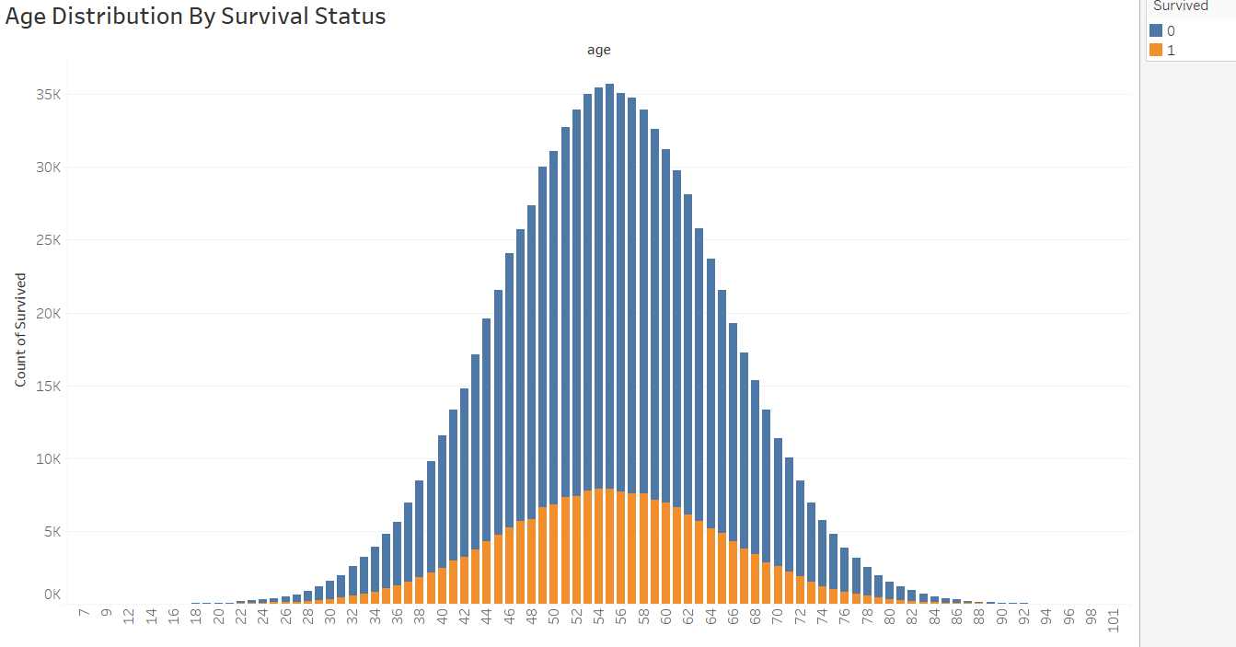
EDA-Survival By Age Distribution

Slide 16
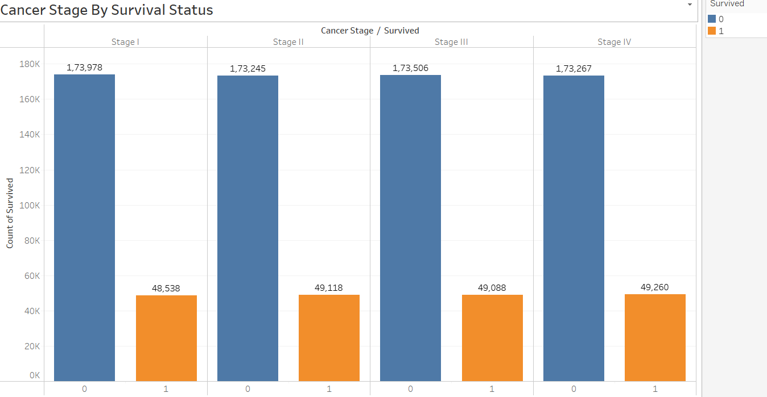
EDA-Survival By Cancer Stage

Slide 17
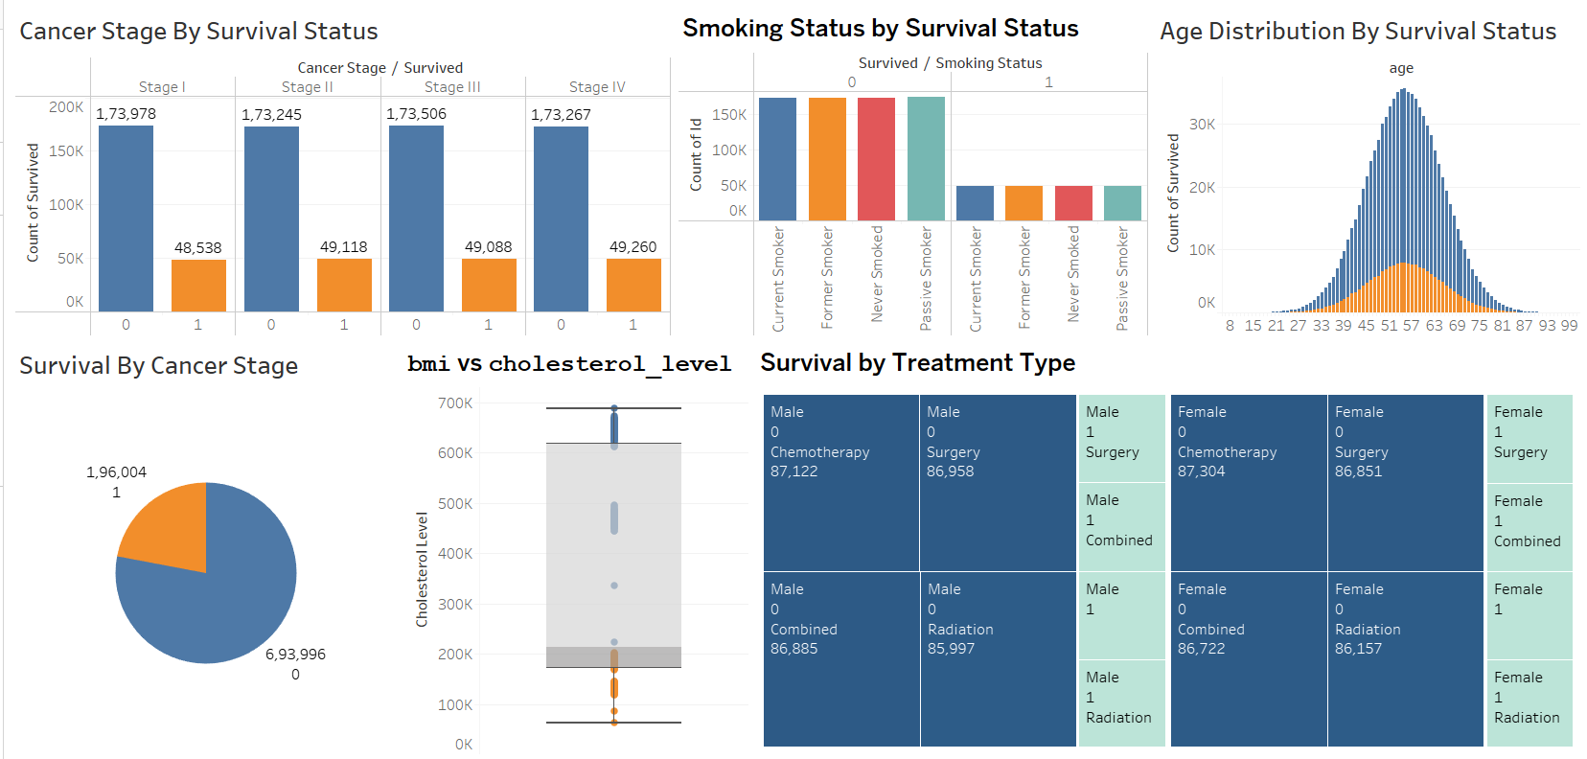
TABLEAU DASHBOARD

Slide 18
CONCLUSION
The project successfully demonstrated an end-to-end machine learning pipeline, from data processing to model deployment. The developed model can serve as a valuable tool to support clinical decision-making and improve patient outcomes.

